Slide 1
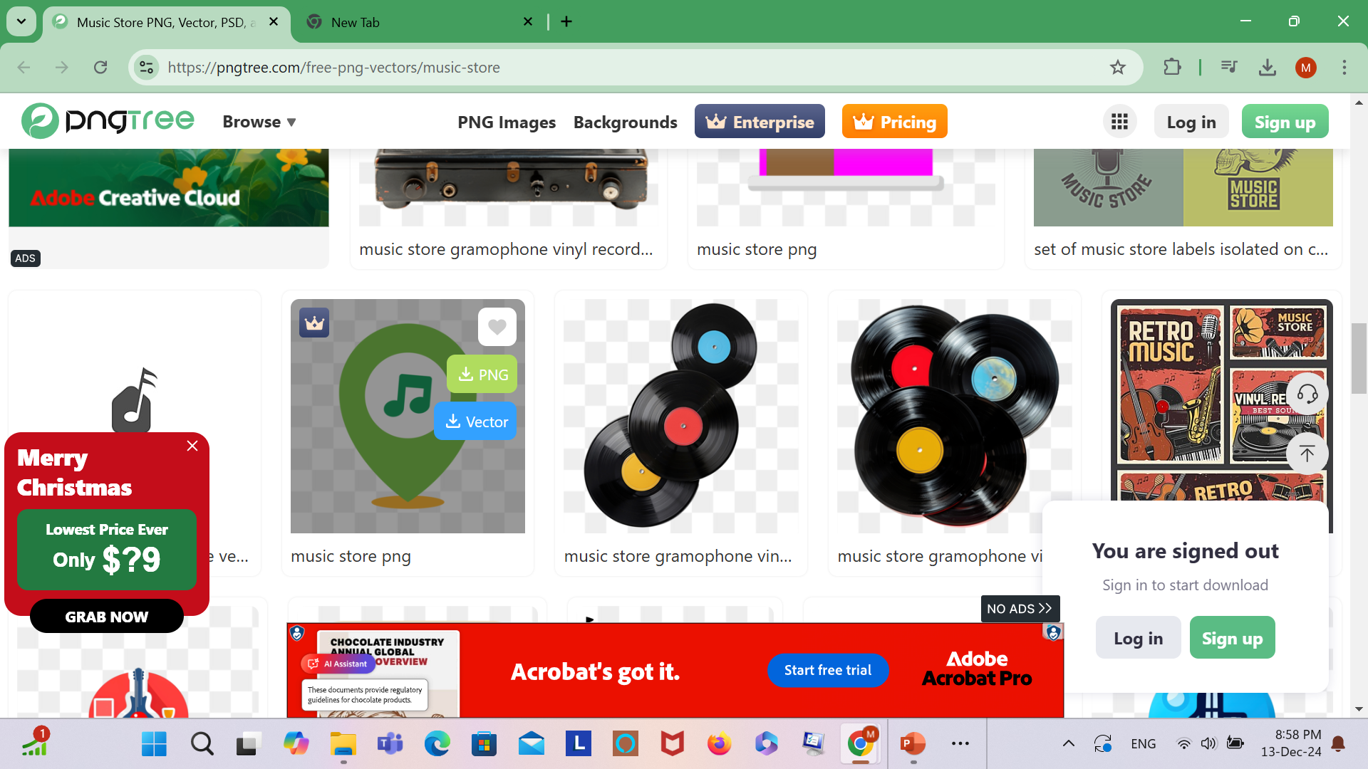
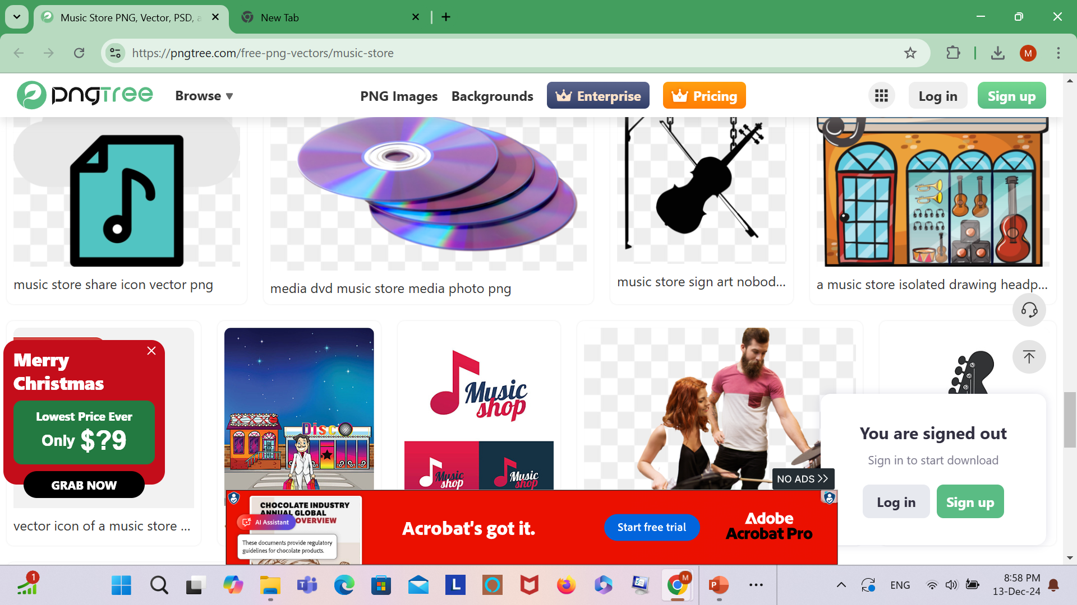
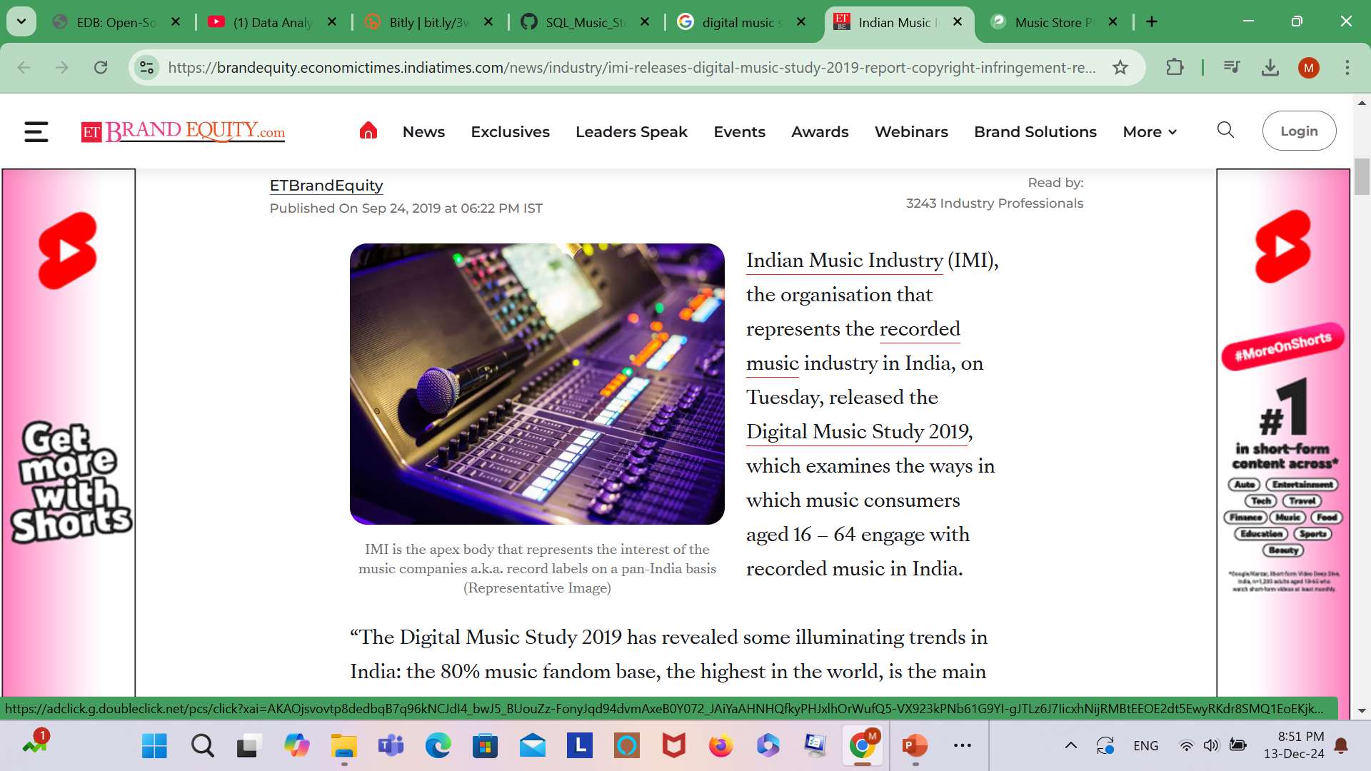
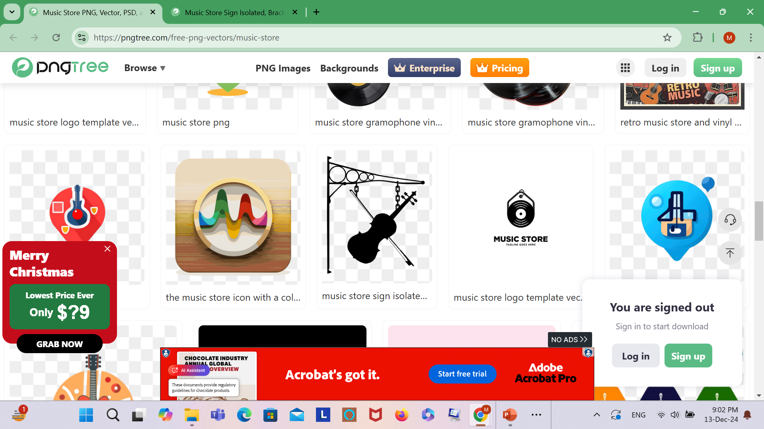
SQL PROJECT Digital Music Store Analysis

Slide 2
OBJECTIVE:
Analyzing a digital music store is to gain insights that can improve the store's performance, customer satisfaction, and profitability.
Examine the dataset with SQL and help the store understand its business growth by answering questions through SQL command.

Slide 3
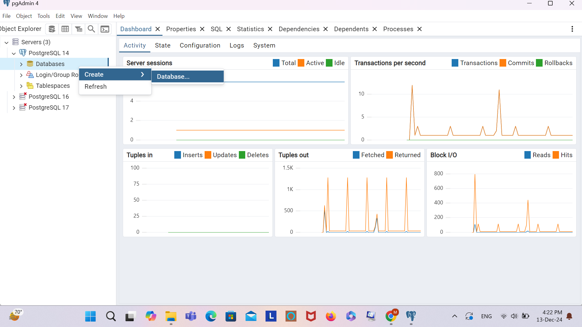
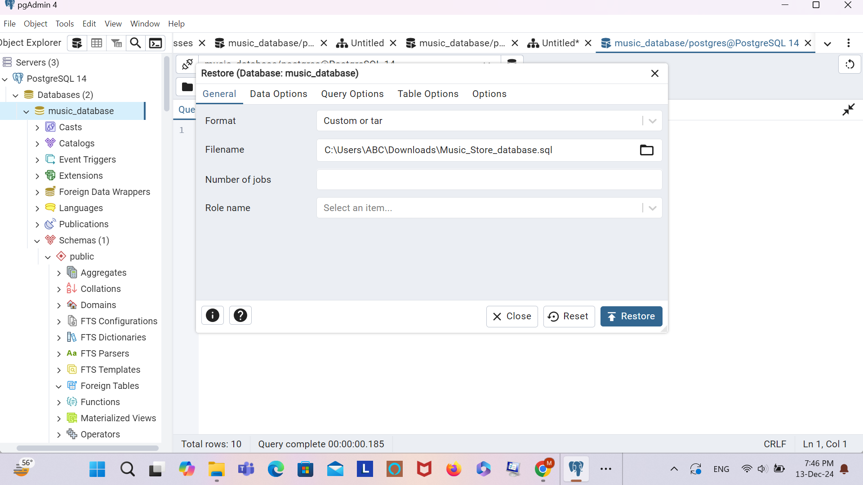
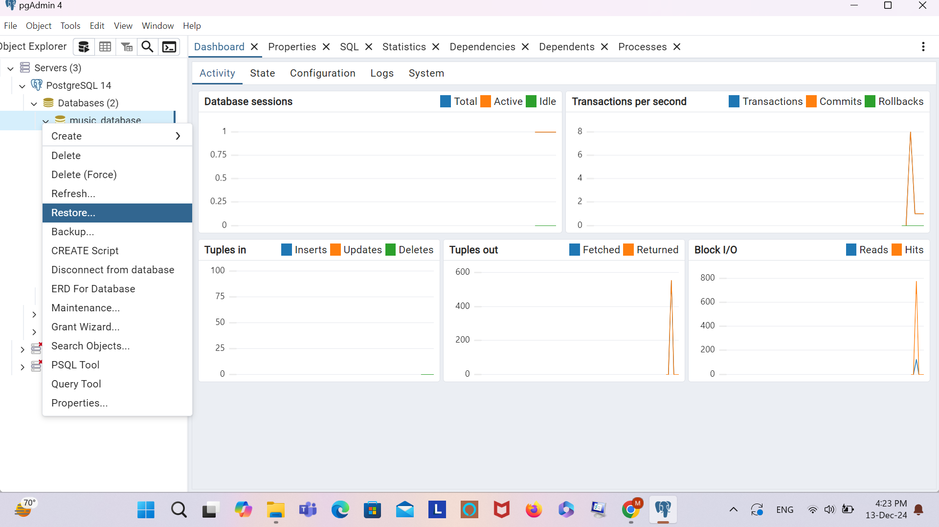
IMPORT DATABASE

Slide 4
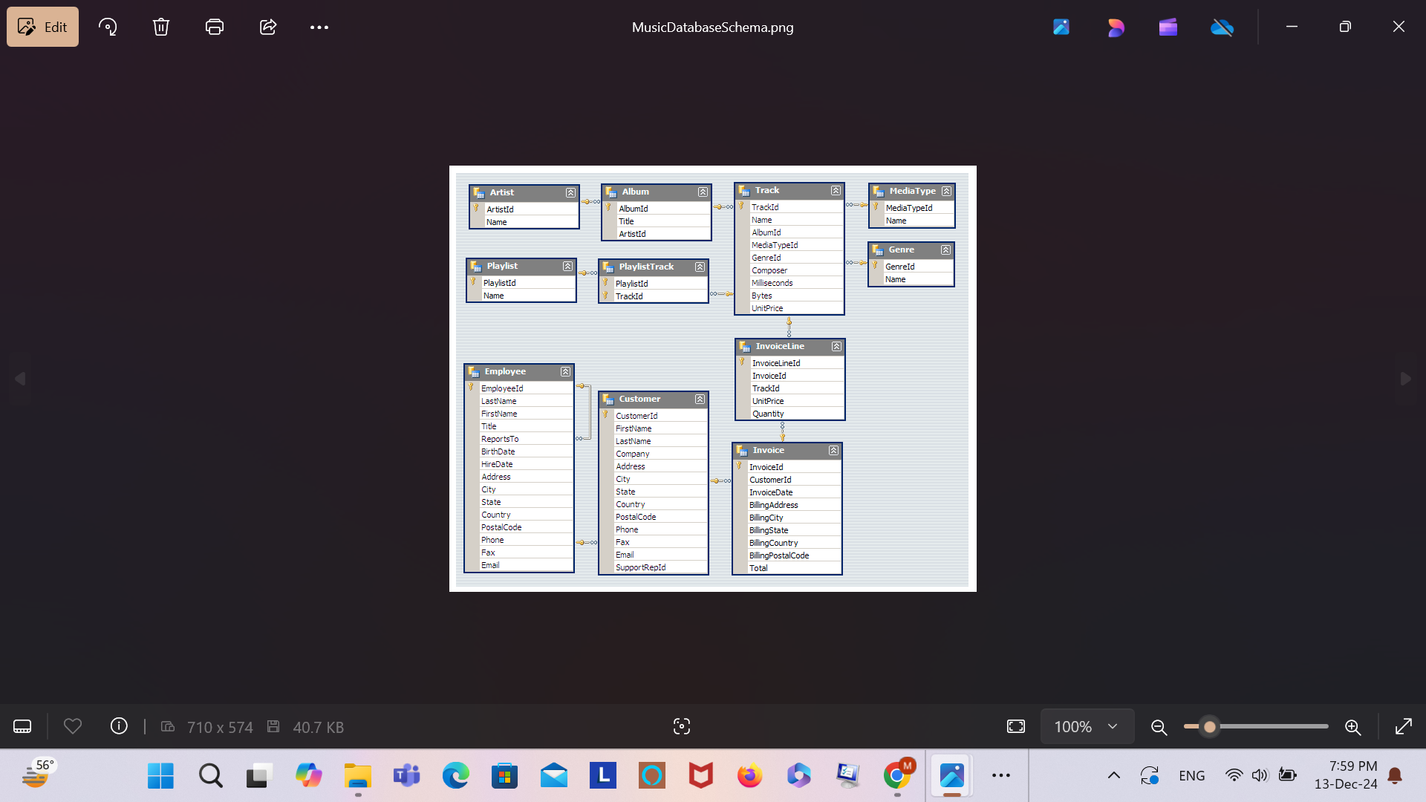
Music Playlist Database
Schema

Slide 5
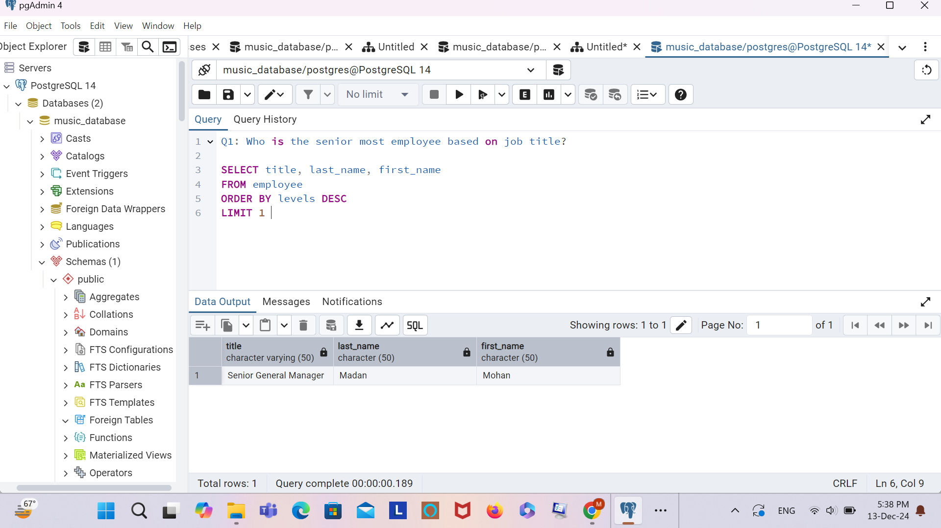
Q. Who is the senior most employee based on job title?

Slide 6
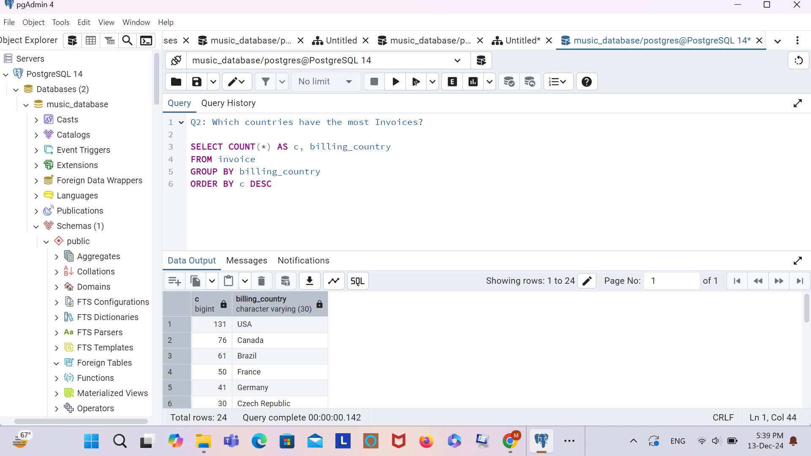
Q: Which countries have the most Invoices?

Slide 7
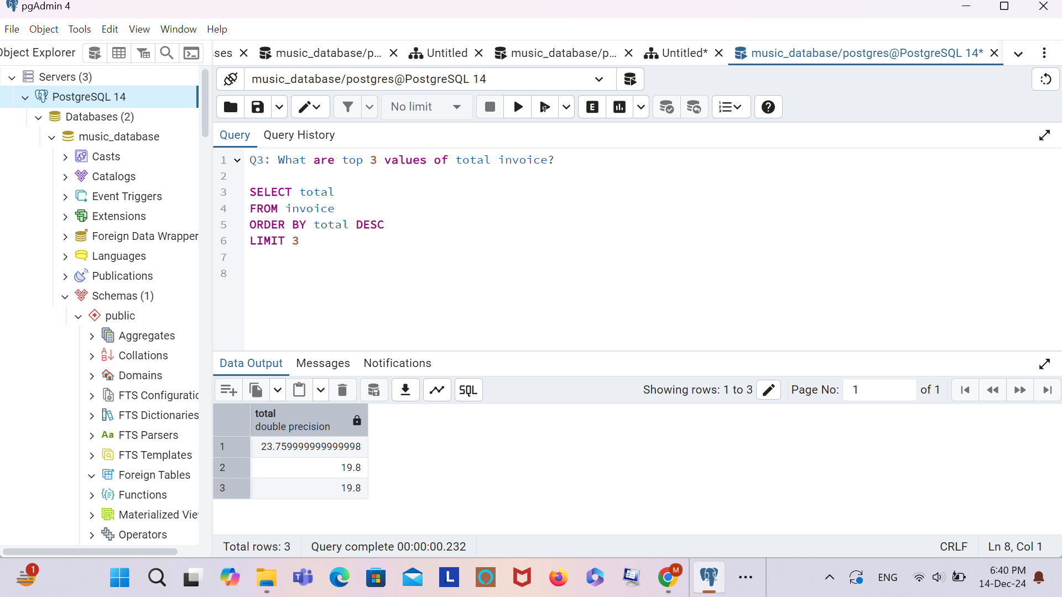
Q: What are top 3 values of total invoice?

Slide 8
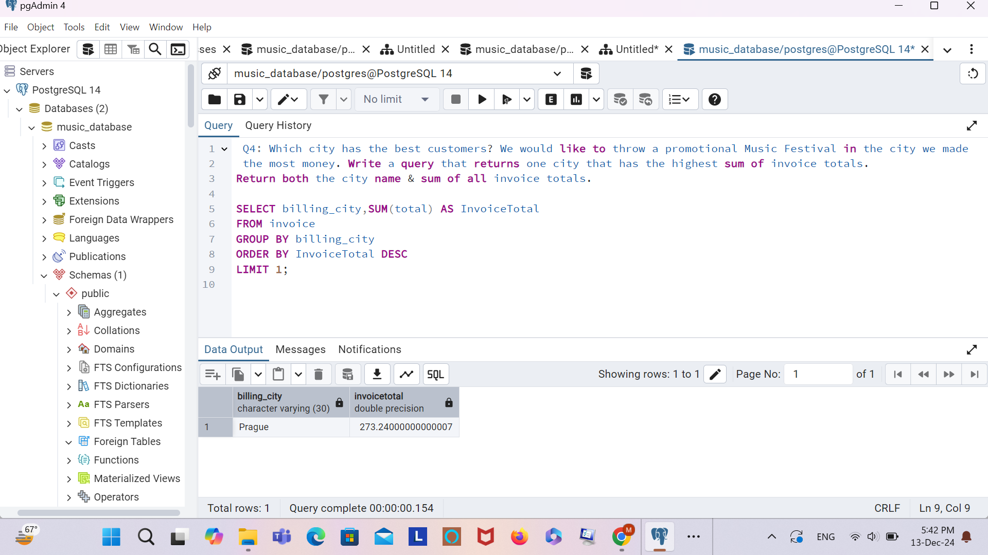
Q: Which city has the best customers? We would like to throw a promotional Music Festival in the city we made the most money. Write a query that returns one city that has the highest sum of invoice totals. Return both the city name & sum of all invoice totals

Slide 9
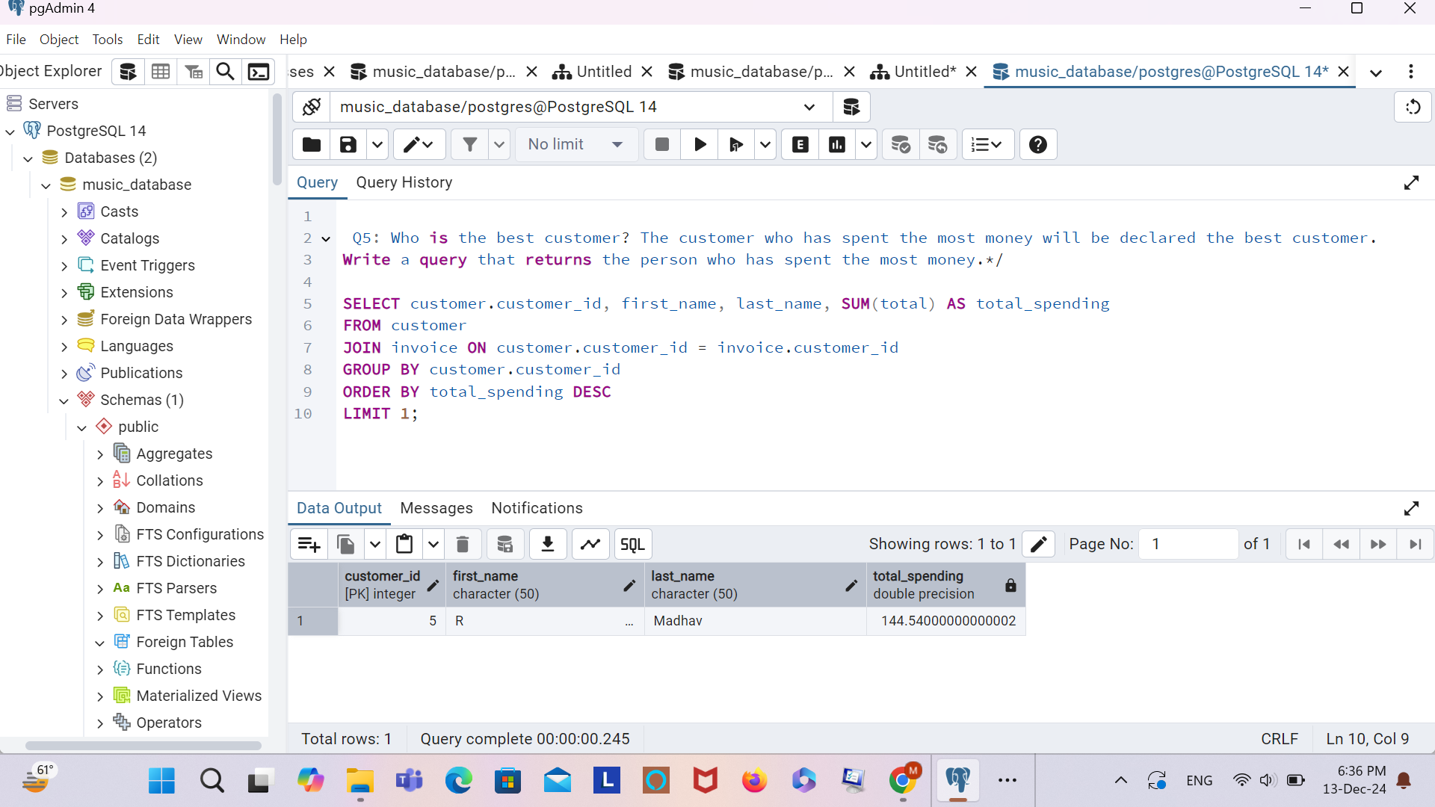
Q: Who is the best customer? The customer who has spent the most money will be declared the best customer. Write a query that returns the person who has spent the most money

Slide 10
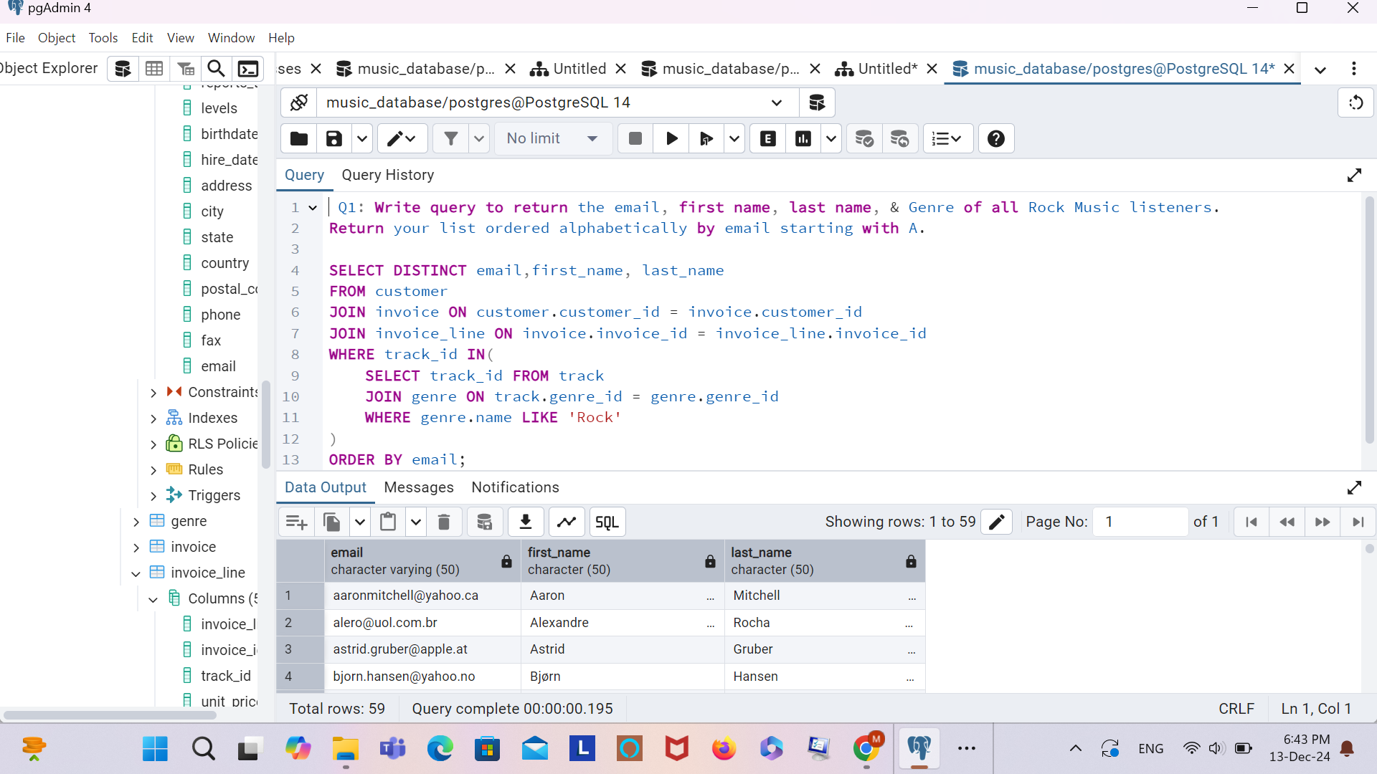
Q: Write query to return the email, first name, last name, & Genre of all Rock Music listeners.
Return your list ordered alphabetically by email starting with A.

Slide 11
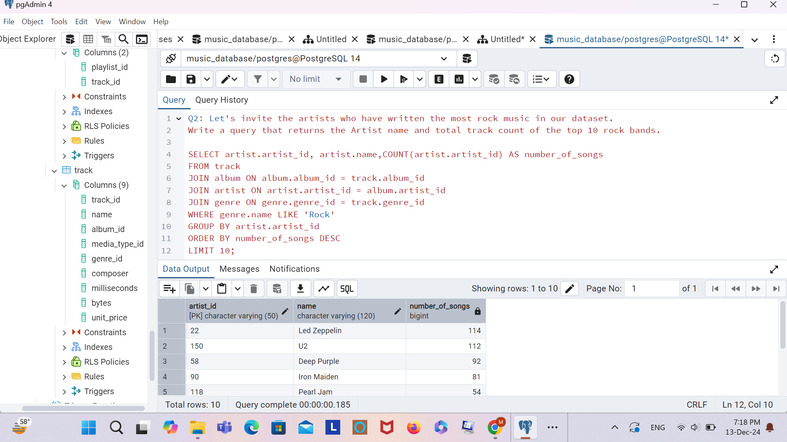
Q2: Let's invite the artists who have written the most rock music in our dataset.
Write a query that returns the Artist name and total track count of the top 10 rock bands.

Slide 12
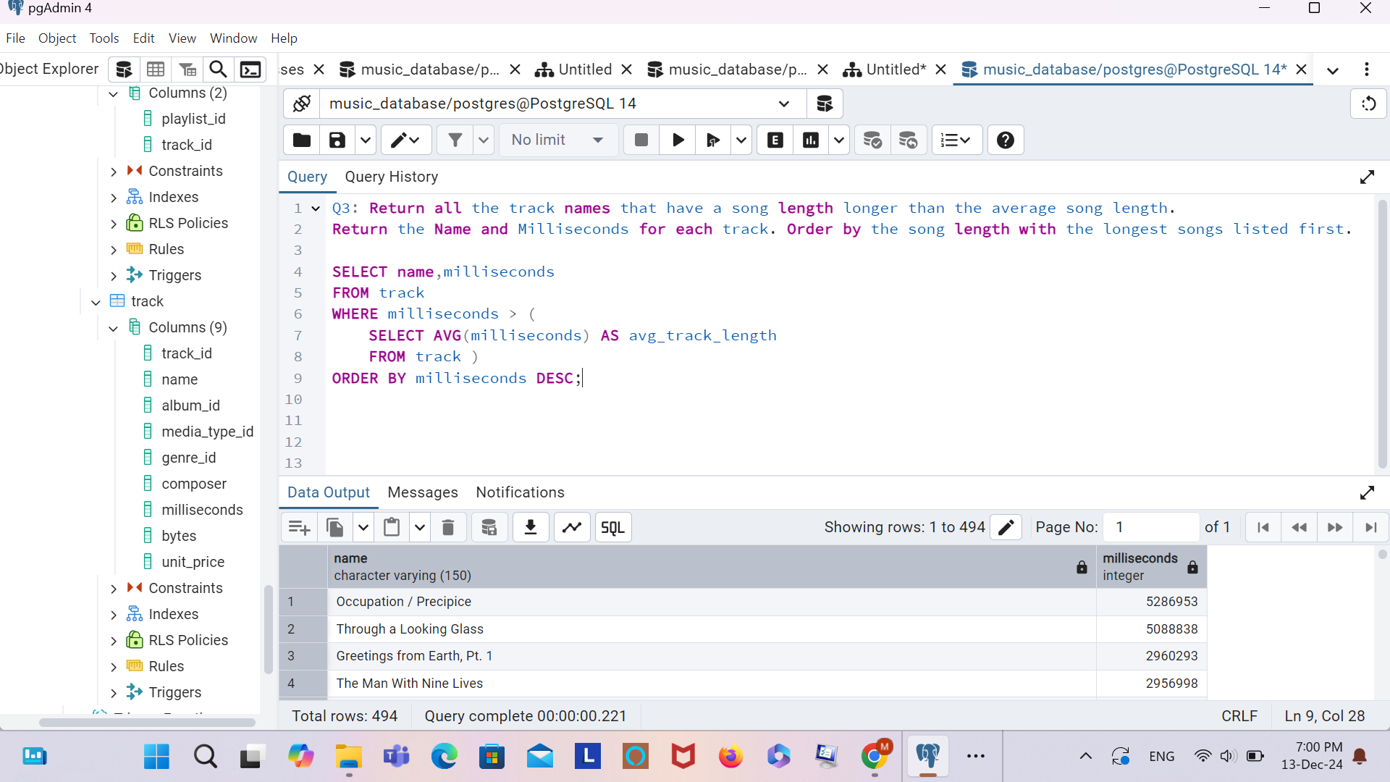
Q: Return all the track names that have a song length longer than the average song length.
Return the Name and Milliseconds for each track. Order by the song length with the longest songs listed first.

Slide 13
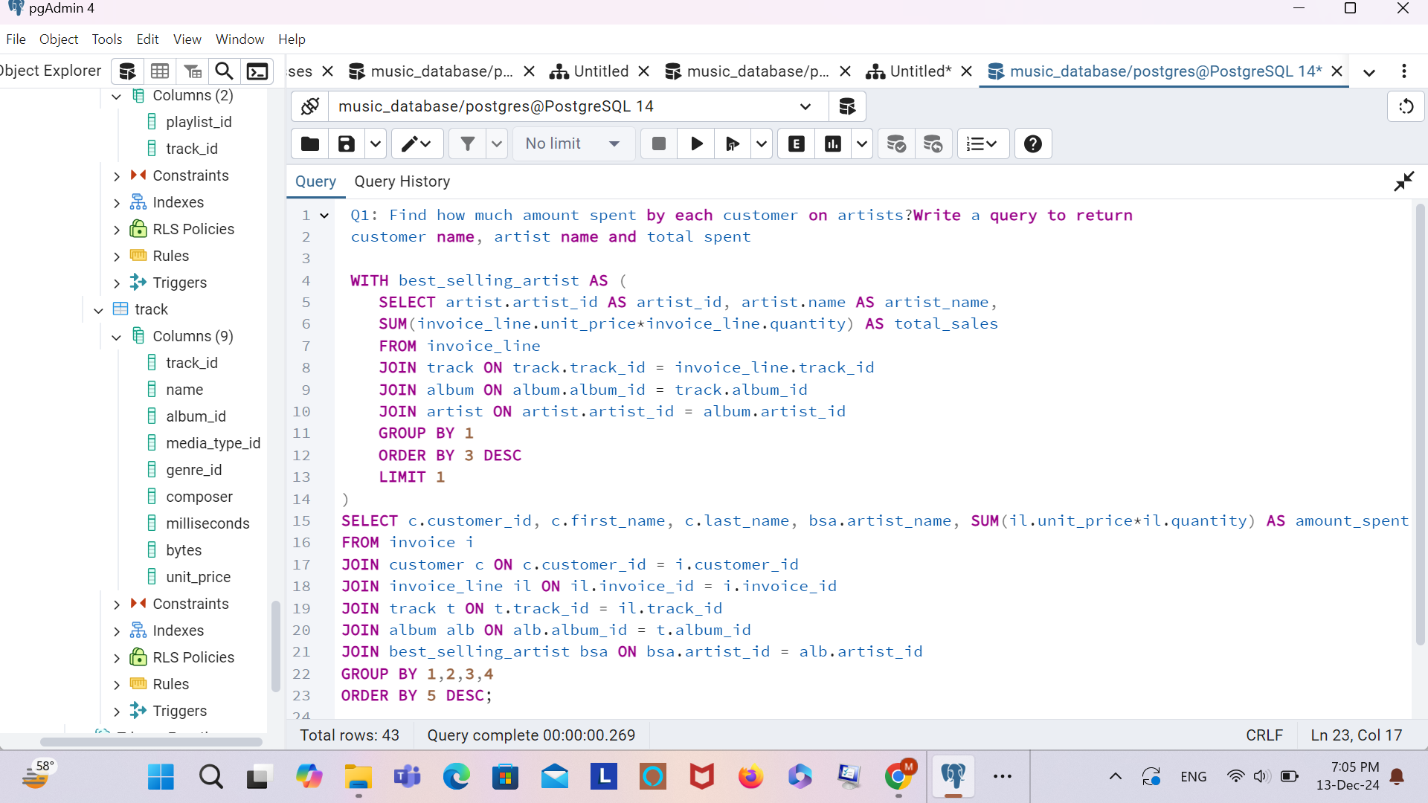
Q: Find how much amount spent by each customer on artists? Write a query to return customer name, artist name and total spent

Slide 14
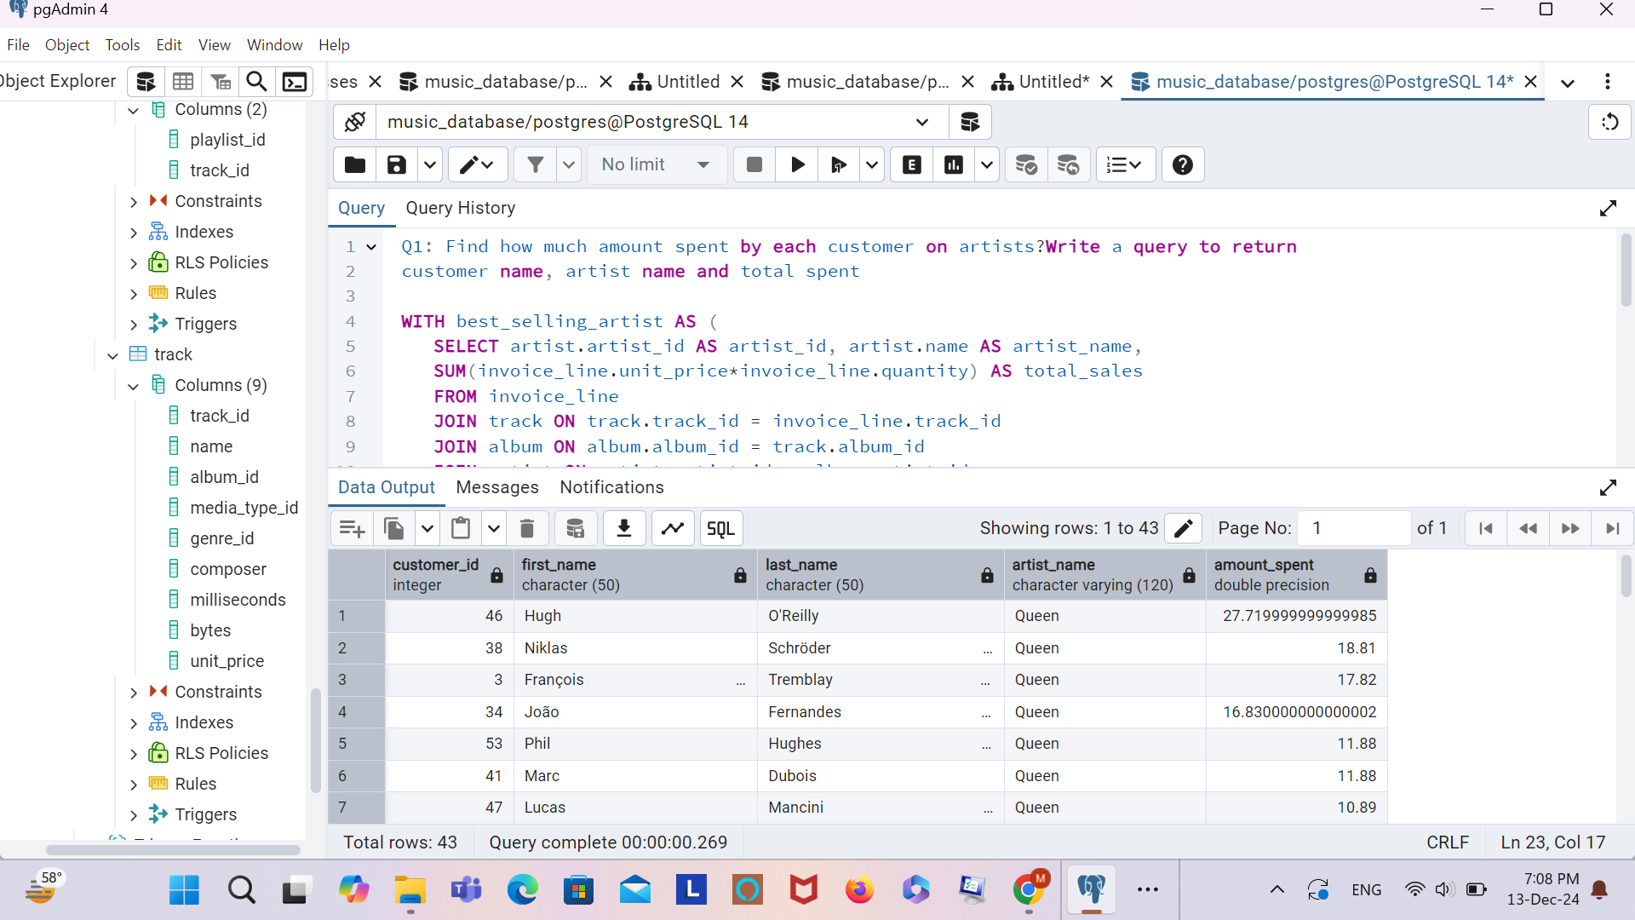
Q: Find how much amount spent by each customer on artists? Write a query to return customer name, artist name and total spent
OUTPUT

Slide 15
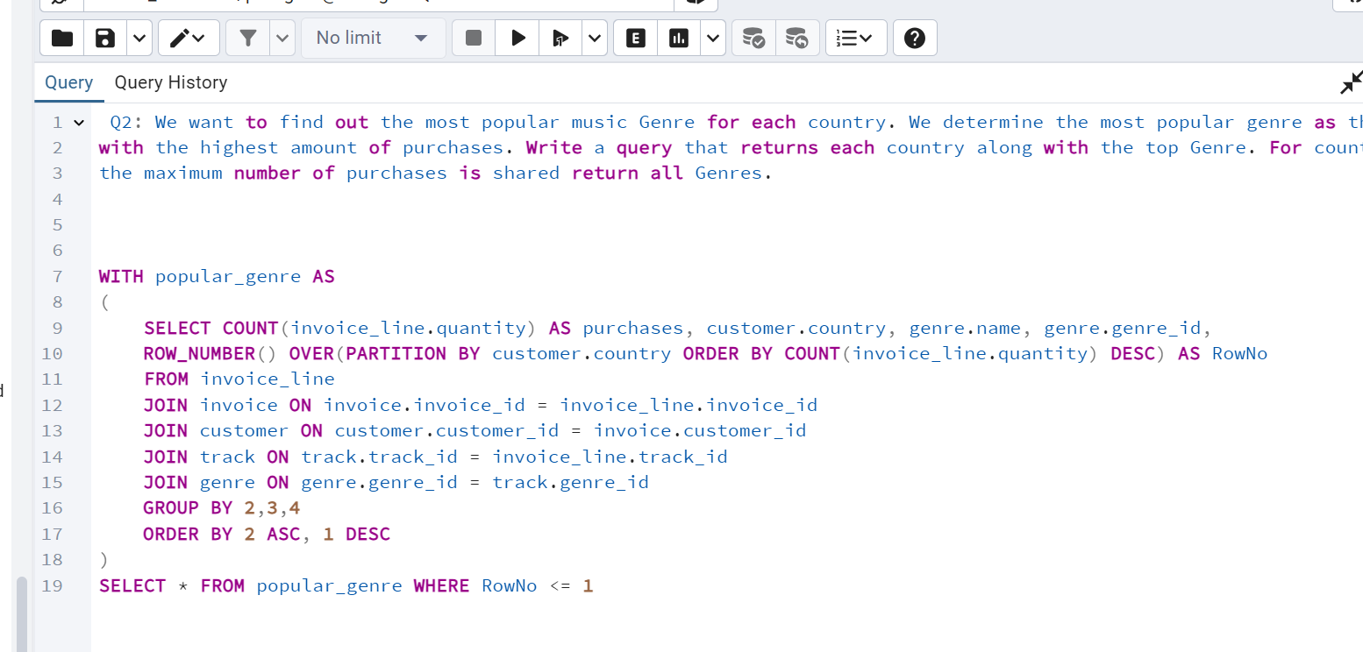
Q: We want to find out the most popular music Genre for each country. We determine the most popular genre as the genre with the highest amount of purchases. Write a query that returns each country along with the top Genre. For countries where the maximum number of purchases is shared return all Genres.

Slide 16
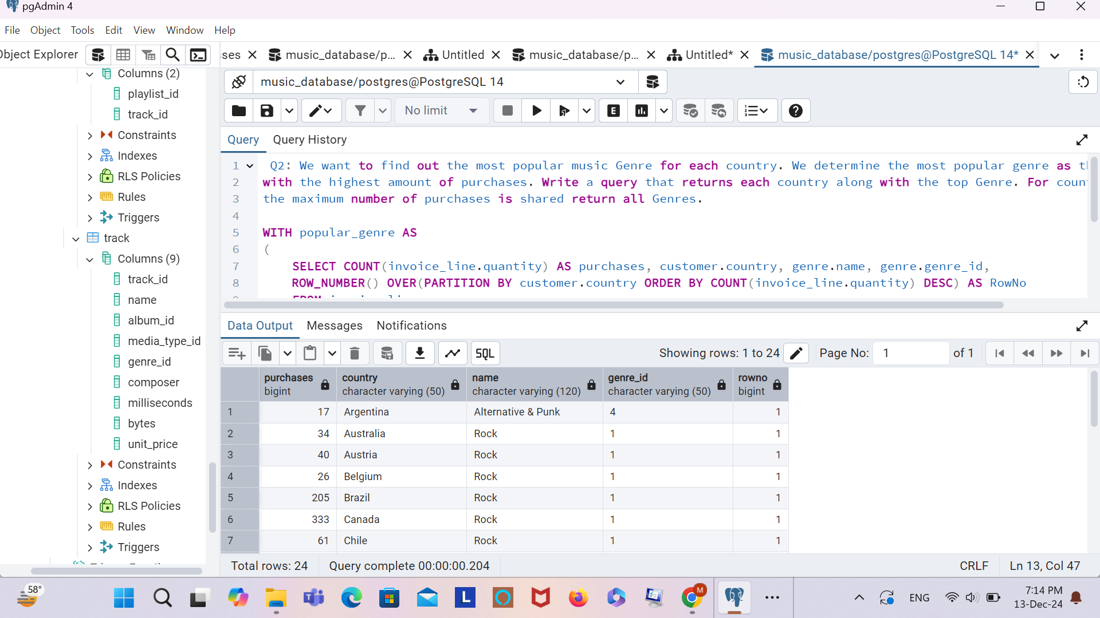
Q: We want to find out the most popular music Genre for each country. We determine the most popular genre as the genre with the highest amount of purchases. Write a query that returns each country along with the top Genre. For countries where the maximum number of purchases is shared return all Genres.
OUTPUT

